Slide 1
Professional Practice of Education Assistants
Roles and Responsibilities

Slide 2


Slide 3


Collaboration
Educators share responsibility for student success
Roles are clearly defined
Communication between the teacher and EA is clear, frequent and timely
Clear expectations are provided within the daily schedule

Slide 4

Collaboration
Both the teacher and EA have a clear understanding of the instructional concepts, methods and strategies
Student needs are known and developments are communicated between the EA and the teacher

Slide 5
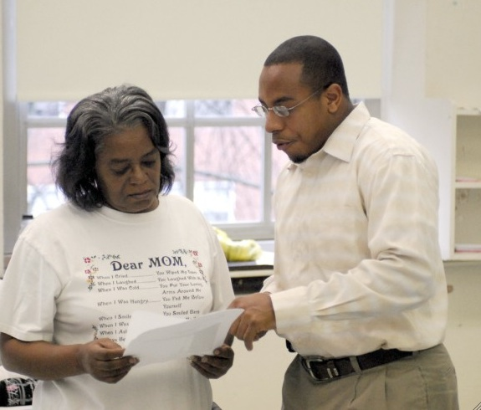
Collaboration
Communication about students needs to take place regularly and consistently during the day or class period:
  Written notes
  “On the fly” directions or specific comments
  Brief meeting at the end of the week
  Scheduled planning meetings

Slide 6
CUPE/BCTF Joint Paper, 2010
Intended to assist teachers and teacher assistants in establishing a co-operative, respectful working relationship to ensure the success of students with special needs
Teacher assistants work under the general direction of a teacher, and under the supervision of an Administrative Officer
“Teacher” in this document refers to all teachers including classroom teachers, special education support teachers, learning assistance teachers and other non-enrolling teachers

Slide 7
Specific Responsibilities
Designing programs and planning learning experiences for students with special needs
Implementing programs for students with special needs: delivery of services
Assessing, evaluating, reporting and recording student progress
Developing supportive environments: for learners, their families, school and district staff

Slide 8

Activity: What’s Your Role?
Label a large sheet with the category and 3 columns: teacher, shared and teacher assistant.
Organize the statements, as they relate to each other, under the headings: teacher, shared and teacher (education) assistant.
Keep the same coloured pieces on the same sheet!

Slide 9
Activity: What’s Your Role?
Example: Assessing, evaluating, reporting and recording student progress
Teacher | Shared | Teacher Assistant
Maintains required school, school district, and provincial records | Clarify data requirements | Assists in maintaining learner records required by school, school district, or provincial policy

Slide 10

Questions for Discussion
What do you understand as a result of having done this activity?
What are the implications for your day-to-day work, interactions and communication?

Slide 11

A few websites for Education Assistants
www.cupe.ca/campaigns/education-assistant (Recognition and Respect, 2008; working conditions of EAs)
www.cec.sped.org (paraeducators preparation guidelines)
www.sseac.ca (learning options for EAs, developed by support staff education and adjustment committee)

